Slide 1
Architecture of Driving Games
Nathan Bonavia Zammit – 0198402l
Anthony Mifsud – 0012002L

Slide 2
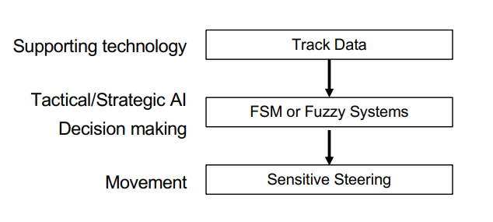
AI Architecture of Driving Games

Slide 3
AI Techniques in Driving Games
In the Driving genre of games the main focus of AI is on the movement of the other NPCs
The movement of said NPCs must seem realistic in their goals
  Whether that be trying to finish first in a race
  Or simply driving around in traffic to get to their destination
  This is mostly achieved through Tactical Reasoning and Route Finding which go hand in hand.

Slide 4
Driving Line

